Slide 1
Software Security - I
Pawan Bhandari

Slide 2
#include<stdio.h>
#include<string.h>
int main(int argc, char *argv[])
{
if(1 < argc)
{
printf("Incorrect number of input parametrs\n");
return 1;
}
const char passwd[10] = “passwd”;
char input[16];
while(1)
{
printf("Enter password: ");
scanf("%s",input);
if(0 == strcmp(passwd,input))
break;
}
printf("Voila!\n");
return 0;
}
Any
Issue
Here?
Notes:
gdb analysis of the program regarding buffer overflow nicely explained in https://www.youtube.com/watch?v=GqmQg-cszw4 after time 50:04

Slide 3
Agenda
Introduction
Programming Language
Buffer Overflow
Data Issues
Let’s Defense
Web Vulnerabilities
Future Pointers

Slide 4
INTRODUCTION

Slide 5
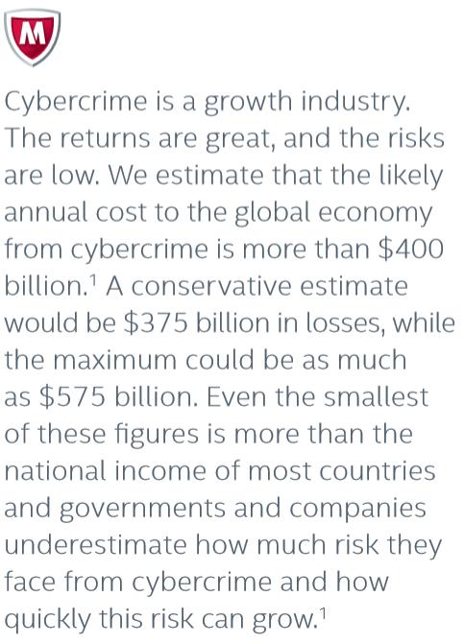
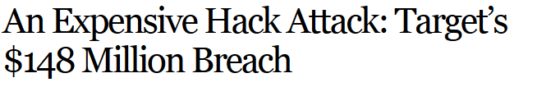
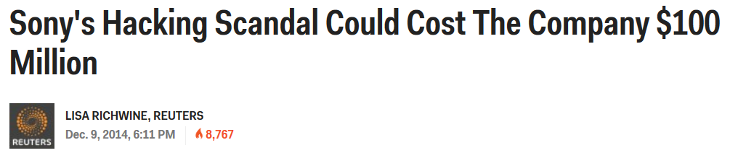
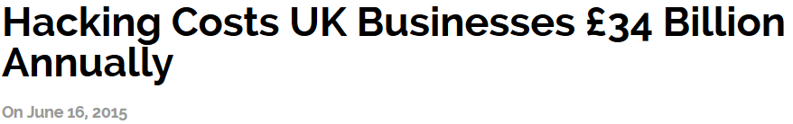
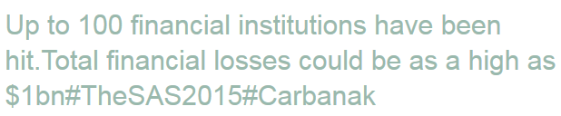
What is at Stake
Notes:
The numbers for Sony even went upto $171 million
Target hack could be upto $450 million

Slide 6
Stakeholders
People
Passwords, Bank/Credit Card details, Personal Information etc.
Researchers
Chrysler, GM
Banks, Stock Markets, Financial Organization
JP Morgan Chase
Small/Large Business
OlaCabs, Ebay, Sony, LinkedIn, NASA, ISRO and many more…..
Countries
India, USA, UK, Japan, Pakistan, Iran, S. Korea, and every single country
Notes:
http://www.wired.com/2015/07/hackers-remotely-kill-jeep-highway/
http://www.informationisbeautiful.net/visualizations/worlds-biggest-data-breaches-hacks/

Slide 7
Attackers
Trusted Insiders
Hackers/Hactivist
Terrorist and Extremist Groups
Industrial Spies and Organized Crime Groups
Nation States
Less Structured
Less Skilled
Highly Structured
Highly Skilled

Slide 8
Our Goal
Understand how the attack works and defend against them
This require knowledge about
Operating System
Architecture
Compiler
Analyzing security requires complete system view
Notes:
http://www.wired.com/2015/07/hackers-remotely-kill-jeep-highway/
http://www.informationisbeautiful.net/visualizations/worlds-biggest-data-breaches-hacks/

Slide 9
PROGRAMMING LANGUAGE

Slide 10
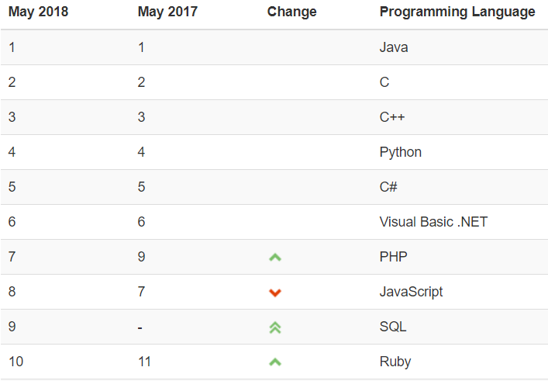
Why C/C++
C/C++ are in top 3
Used in many critical systems
Notes:
http://www.tiobe.com/index.php/content/paperinfo/tpci/index.html

Slide 11
Why C/C++ is Important
Major OS (kernel) and related utilities
shell
High-performance servers
Apache serve
Microsoft SQL server
Many embedded systems
Mars rover

Slide 12
BUFFER OVERFLOW

Slide 13
Memory layout of x86
cmdline & ENV variables
0xFFFFFFFF
STACK
HEAP
(UNINITIALIZED DATA)
DATA SEGMENT
(INITIALIZED DATA)
TEXT/CODE SEGMENT
0x00000000
Notes:
Text Segment: This is also known as data segment. The executable binary of the program/code is put into this segment. It is generally kept in read-mode (in Linux) to make sure that it is never over-written.
Data Segment: This segment contains all the data (global, extern, static variables not local variables) which is required throughout program execution. This is generally divided into two physical parts.
Initialized Data Segment: This contains data that has been explicitly initialized by the program.
Uninitialized Data Segment: This contains data that has not been explicitly initialized by the program. Global variables not initialize by program are assured by the process model to be zero.
Heap: is the segment which is being used for all the dynamic memory allocations. In the C source code of the user program, standard library function malloc(), calloc() or alloc() , realloc() are used to allocate linear memory dynamically.
Stack: All the local variables that are created when control enters as function are stored in stack. Every time a function is called some more information is also stored in stack including the address where to return to and parameters passed in function.

Slide 14
Buffer Overflow
Buffer is contiguous memory associated with a variable e.g. `char` array in C
Buffer Overflow is any access of a buffer outside of allocated bounds (before or after)
over-read
over-write
Notes:
Other than `char` array, dynamically allocated memory using `malloc()` etc. is also an example of buffer.
Other terms such as buffer underflow (write before the start of allocated memory), buffer over-read (read after the end), out-of-bound access etc. are also popular in usage.

Slide 15
But why are we even talking of “Buffer Overflow”?

Slide 16
Buffer Overflow contd.
Buffer overflow is a `BUG`.
Normally this bug will cause system to crash (in fact its good if crash)
It can have significant security impacts on low-level programming language.
Attacker can use these conditions to:
Steal private information
Corrupt important (valuable) information
Execute his/her own code (aka Code Injection)
Most common form of
security vulnerability

Slide 17
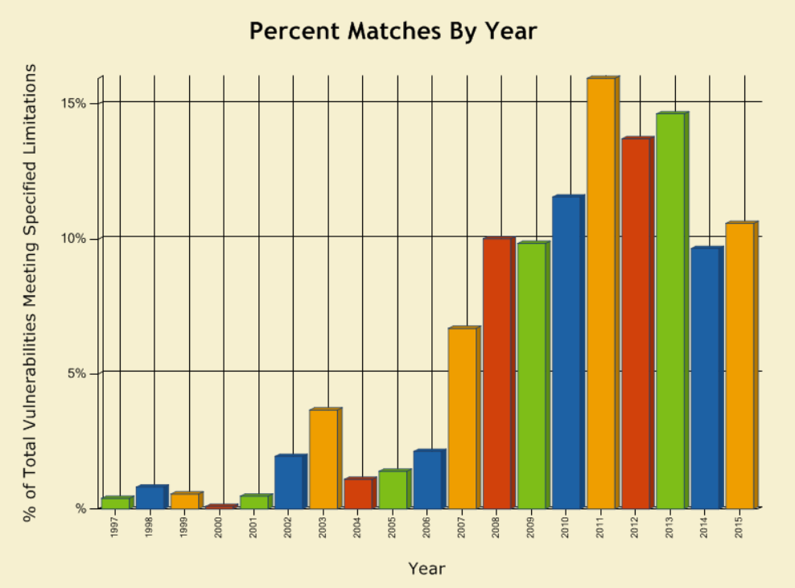
Buffer Overflow Trends
Notes:
https://web.nvd.nist.gov/view/vuln/statistics-results?adv_search=true&cves=on&cwe_id=CWE-119

Slide 18
Program - Revisit
int main(int argc, char *argv[])
{
if(1 < argc)
{
printf("Incorrect number of input parametrs\n");
return 1;
}
const char passwd[10] = “passwd";
char input[16];
while(1)
{
printf("Enter password: ");
scanf("%s",&input);
if(0 == strcmp(passwd,input))
break;
}
printf("Voila!\n");
return 0;
}
d
w
s
s
a
p
passwd
input

Slide 19
Program – Revisit contd.
E
R
E
H
T
N
A
W
I
R
E
V
E
T
A
H
W
after
scanf(“%s”,&input);
And “passwd” is overwritten
passwd
input

Slide 20
DATA ISSUES

Slide 21
Potential Inputs for Buffer Overflow
Text Input
File Input
Environment Variables
Packets (Messages)

Slide 22
Plain Text File Input
PAM (Pluggable Authentication Module) service in Linux is used for authentication
If integrated with LDAP (Lightweight Directory Access Protocol), “pam_ldap.conf” file is required
WOW!!!!, username and password to LDAP server is in plain text. Easy target to hack

Slide 23
Other Sources of Buffer Overflow
Buffer Overflow (Read/Write Overflow)
Heap Overflow
Integer Overflow
Stale Memory

Slide 24
LET’S DEFENSE

Slide 25
Behind the Scene – Attacker Perspective
Attacker gets the control of the data
Usage of such data permits access to memory area
Now, attacker has all the control of the system

Slide 26
Secure Development Life Cycle
Different than regular Software Development Life Cycle
Security is required at every step of development:
Requirements (Architectural Risk Analysis, Security Requirement)
Design (Security Oriented Design)
Implementation (Secure Coding, Code Reviews)
Testing/ Quality Assurance (Security Tests, Penetration Testing)

Slide 27
Security Requirements
Security policies and goals:
E.g. one person’s data (email/account) shall not be seen (or modified) by other users
Required mechanism to enforce them
E.g. users needs to be authenticated using password
E.g. Based on the role, user can access the data
Authentication, Authorization are the keys

Slide 28
Security Oriented Design
Design Software which has:
Prevention (Authentication using passwords, Firewall)
Detection (Monitoring, Logging operational activities)
Mitigation (Authorization, Data encryption)
Recovery (Back-up)

Slide 29
Secure Coding
My view - Secure Coding is just a common sense with system knowledge
The intention is to leave no loop-holes in the system:
Unattended data
Dangling pointers
Unclean memory
Unused/Temporary files
Open sockets

Slide 30
Principles of Secure Coding
Never trust user
Never ignore compiler warnings
Validate input & data sanity
Return oriented programming
Use NULL after free
Data encryption
Have defense & recovery mechanism
Don’t try adventurous coding (avoid complex code)
Use safer APIs (good coding practices)
Notes:
https://security.berkeley.edu/content/application-software-security-guidelines
https://msdn.microsoft.com/en-us/library/d55zzx87%28v=vs.90%29.aspx
https://developer.apple.com/library/mac/documentation/Security/Conceptual/SecureCodingGuide/Introduction.html

Slide 31
Safe `C` APIs
Need of safe `C` APIs
The standard `C` APIs are decades old, thus doesn’t address today’s security issues
e.g. strcpy(dest,src) doesn’t check buffer boundaries
Strong Points
Input validation to avoid buffer overflows
Have return values
Challenges
Slow performance
More code is required to handle return codes
Notes:
http://sourceforge.net/projects/safeclib/

Slide 32
Safe `C` string APIs list
Standard `C` API | Safe `C` API | Safer API
strcpy | strncpy | strlcpy
strcat | strncat | strlcat
sprintf | snprintf
gets | fgets
Standard `C` API | Safe `C` API (Microsoft Versions)
strcpy(dest, src) | strcpy_s(dest, size, src)
strcat(dest, src) | strcat_s(dest, size, src)
strlen(str) | strnlen_s(str, maxcnt)
Notes:
http://sourceforge.net/projects/safeclib/

Slide 33
Secure Testing
Secure testing is not functional testing
Functional test ensures that legitimate users can use the system conveniently and expectedly with basic checks and safety measures
Secure testing is from attacker’s perspective, which ensures that software is secure
e.g. functional testing ensures that user with non-admin privileges cannot access system files, however secure testing ensures that a non-admin users shall not get admin privileges

Slide 34
Secure Testing Tools
Static Analysis
Coverity, klocwork, Fortify, Lint
Dynamic Analysis
Valgrind
Netspark (Web )
Fuzz Testing (aka Fuzzing)
Penetration testing

Slide 35
Reality = ytilaeR
Most of the people are not even aware of it
Those who are aware, don’t accept till it happens
Lack of resources
Need time/ resources to create secure software
High competition
Short time to market
Everyone is looking for fast solution

Slide 36
Are we done yet?

Slide 37
WEB VULNERABILITIES

Slide 38
SQL Injection
SELECT Age FROM Users WHERE Name=‘Dee’;
Server side Login Code – PHP
$result = mysql_query(“select * from Users where(name=‘$user’ and password=‘$pass’);”);
What if user input as frank’ OR 1=1); --
$result = mysql_query(“select * from Users where(name=‘frank’ OR 1=1); --’ and password=‘whocares’);”);

Slide 39
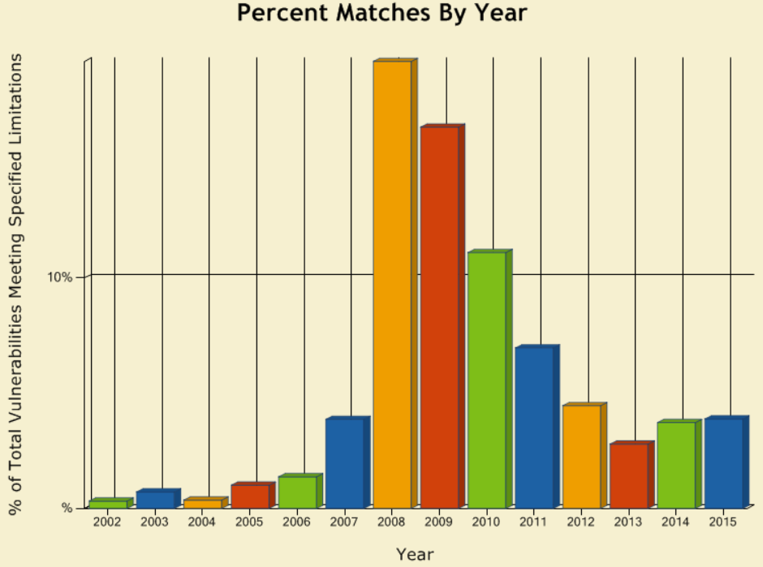
SQL Injection Trends
Notes:
https://web.nvd.nist.gov/view/vuln/statistics-results?adv_search=true&cves=on&cwe_id=CWE-89

Slide 40
Weak Areas
URL parameters
http://tgt.com/buy?item=1&price=5.00
Default user & password
E.g. root, admin
Hidden files & directories

Slide 41
FUTURE POINTERS

Slide 42
Future Learning
HTTP
Session Cookies
CSRF (Cross-Site Request Forgery)
XSS (Cross-Site Scripting)

Slide 43
References
http://www.cse.scu.edu/~tschwarz/coen152_05/Lectures/BufferOverflow.html
https://crypto.stanford.edu/cs155/papers/cowan-vulnerability.pdf
http://heartbleed.com/

Slide 44
Thank You

